Slide 1

Network Technologies for 2030 Networks
Delivering the Promise
of Future Media by 2030
Toerless.Eckert@Futurewei.com, Santa Clara, CA, USA
IEEE International Conference on Cloud Networking
6. November 2019, Coimbra, Portugal

Slide 2

Technologies for 2030 Networks
WHY
more users, (IOT) devices, quality, critical/future applications, …
WHERE
Metropolitan network infrastructures (fixed/mobile) (for this slide deck)
WHAT
New network protocol/services technologies
NewIP, High-Precision, Qualitative Comms, Holographic, …
....
GREAT SUCCESS ! ??

Slide 3

WHERE: from Internet to ManyNets
Internet: Global Connectivity, Best Effort
Manynets: private (global) backbones
SP3
SP4
SP and ASP global backbones
SP1
transit
SP2
DC
DC
DC
DC
DC
DC
DC
The Internet
Peering, Interconnects, Hosting
Service
One network to rule them all
User
Metro Nets
Private Networks
Access SP
Users
Devices
Users
Devices
Users
TCP/IP was/still-is designed for multi-transit Internet (1970th)
Since ca. 2010:
Scaling global services requires Edge Data-Center (Cloud)
Raise of global ASP, peerings, cloud services, Death of transit

Slide 4
WHERE: 2030 Internet Front-haul / Backhaul
Traditional Internet / transit traffic: best effort, > 20 msec RTT
2020: 70% visible user traffic
ASP and Internet Transit traffic
2030: High Precision traffic
space networks extending to users
Space Networks – public / private
Users
Edge
DCs
Metro Networks
“private” ASP (content + app sync distr.)
Devices
Edge
DCs
“private” Content Provider (caching, streaming)
Users
Private Networks
Interconnects
OTT Content/App. provider “backbone”
Devices
Peerings
Internet transit backbone
Users
SP access networks
Exchanges
“public” ISP global backbones
Access
Edge-Cloud(s)
public, private, telco
Global Backbones
Private (physical, OTT/Internet), “public”
High Precision Fron-thaul
ManyNets/Transit Backhaul

Slide 5

Network 2030 Internet Front-haul Opportunity for better services
Internet: Global Connectivity, Best Effort
Transit has no business relationship with neither user nor service
Key reason for current Internet to be limited to “Best Effort” (BE) services
Fronthaul can be architected without transit.
Key enabler for better than BE services in 2030 networks.
User/Service <-> User/Service: 2 networks + interconnect.
Geographical limits (e.g.: 100 mile diameter) of Front-haul permits latency critical services.
Limited physical latency (low msec).
SP3
SP4
SP1
transit
SP2
Service
One network to rule them all
User
The Internet
Internet 2030 Fronthaul
Users
Service
Devices
Metro Networks
Interconnects
Users
Private Networks
Peerings
Devices
Exchanges
Users
SP access networks
Service
Access
Edge-Cloud(s)
public, private, telco

Slide 6
Technologies for 2030 Networks Refined 2030 Network Solutions Dependencies
WHY
WHERE
WHO
Develops 2030 Network services
Operates 2030 Network services
HOW
What technologies do we need to enable WHO ?
WHAT
…
GREAT SUCCESS !!???
Forgot
Something

Slide 7


WHO: Enable Innovation & Opportunity
Cloud drives Innovation & Opportunity
Software-ization is enabler for new Service Developers and Services Operator
DC-networks: becoming softwareized (P4,..)
Telco-Cloud => Software
5G ‘Network’, VPN, Security, Content services
MVNO, SD-WAN, ..
But Software is not 100Gbps…Tbps
Metro-Wireline Networks ?
Today: Speeds, Feed, Commoditization.
Key Technology gap:
Software-izable Tbps Internet 2030 access networks
Internet 2030 Fronthaul
Innovation poor
Users
Metro
Service
Devices
Private
Interconnects
Service
Users
Peerings
Service
Devices
SP access
Exchanges
Service
Users
Mobile
Data-centers
Innovation rich

Slide 8
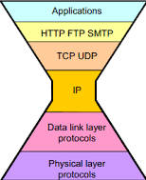
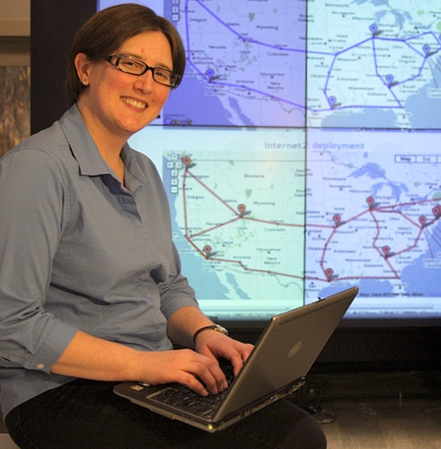
HOW: Software-ized Metro-Network
How to deploy & sell new network forwarding plane ?
Slices do NOT allow to program new forwarding planes
Overlays - VMs / Containers in Data-Center
No “bare-metal” option (hop-by-hop) on a metro-network (*)
Example (from last decade): Inability of ICN to get deployed
Overlay enough for many network services, but not all:
Speed/Performance, Data-replication,
Latency sensitive: High-Precision, Deterministic, Coordinated, Qualitative, Lossless
Software-ization of Tbps forwarding plane: challenges for a decade
Flexible programming languages (P4 too limited)
Chip cost / power consumption
Virtualization: context overhead VM->Container->Lambda model
Programmable QoS (packet scheduling)
Resource Management (absolute vs. relative)
Innovation Bottleneck
Innovation Above, Below, and Alongside
But, Limited Innovation “Inside” the ’Net
Inside of the network needds to change
We Are Desperate to Innovate Inside
Jennifer Rexford,
ACM Sigcomm 2018 Keynote Speech
(*) Commercial offerings, not talking about research networks from NSF.

Slide 9
Technologies for 2030 Networks
WHY
WHERE
WHO
HOW
WHAT
Current Internet/private network experience “challenged”
Big Packet Protocol
Coordinated Communications
High-Precision Communications
Qualitative Communications
Lossless Networking
Preferred Path Routing
GREAT SUCCESS !!!!?

Slide 10

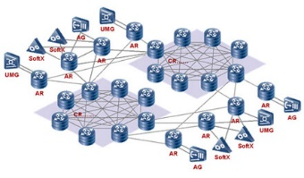
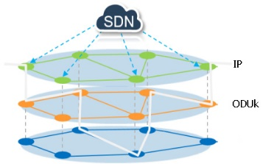

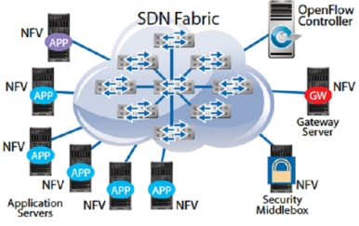


BPP – Big Packet Protocol Architecting the next-generation forwarding plane
Better
Physical servers
Traditional
networks
Network evolution so far:
Primarily evolution of management/(control) plane
Very complex , incrementally grown forwarding planes:
Duplicating efforts, limited in flexibility, Little/not App-“programmable”
Various bad limitations. E.g.:
IPv4 / IPv6, per-feature extension header, parameters per-hop SRv6
fixed size addresses, minimal changeable by network, …
MPLS, fixed size addresses, hacked bottom of stack parameters,…
Ethernet, often same or better QoS features than IP/IP, but all different.
Programmable networks / slices / 2030 services (high precision,..)
Very challenging (if not impossible) to build well within this maze
Can we design / frame a better, unified forwarding plane ?
Unify / superceed existing solutions, extensible
(SLO) “Service Level Objective” based – “Do What i Mean Networking”
Without all the boring bits of history
VM – IaaS, PaaS
SDN
Containers
NFV & SFC
Serverless
(“Lambda”)
BPP
“Networkless ?!”
Application/DC vs. Network evolution

Slide 11
BPP – Big Packet Protocol Key architectural aspect for flexibility
BPP Header
Actions, Parameters and Metadata
Actions (Commands) as Unit of forwarding plane extensibility
Per action parameters, but cross-action shared metadata (to minimize headers)
Explicit indication of sequentialization / parallelization of actions
Flowlets: Integrated state-full and state-less Actions
Per flow actions minimize per-packet header
Per-packet actions allow scale to arbitrary number of flows in network.
Not all actions can be performed per packet, e.g.: limit rate to X Mbps
Efficient stacking or merging of headers
Generalization of MPLS/SR concept for efficient layering / tunneling
Look-ahead across multiple headers ?
Support for different address lengths
128 bit too long/inefficient for most private networks , IoT, replace existing solutions
Many open design issues – translation / integration, multiple instances, assignment authorities, …
Ver 1
X
F
ea ignore
e
0
v
0
len 21
meta
20
r
next proto
Command header
Action “increment”
len
7
n
1
s
1
c
0
p
0
action
increment-by
len
6
n
00
r
np
2
sp1
1
sl1
01 (meta)
Action (contd.)
Command header
sp2
1
sl2
11 (data)
spn
0
sln
0
parameter
metadata total-q-d (offset 0)
parameter
data item: e-q-depth
len
9
n
0
s
0
c
1
Condition
p
0
ctype
> (“gt”)
n
0
c
00
len
5
np
2
sp1
1
sl1
01 (meta)
spn
1
sln
00 (value)
parameter
metadata total-q-d (offset 0)
Cond (contd.)
Action “drop”
parameter
value: 200
p
0
action
drop
len
3
n
00
r
np
0
sp1
0
sl1
01
Metadata
total-q-d 0
Management
Config Interface
Management Interface Agent
Output Interface
Control
Monitoring
Agent
Routing
Protocols
Transport
Resilience (ISSU) …
Policies
Stateful BPP Info Storage
BPP Rules/Policies
BPP Engine
Data Plane on LC
Queues
…
FIB Tables
BPP Processing
Forwarding Ctrl Interface
Receive
Process
Transmit
ASIC

Slide 12
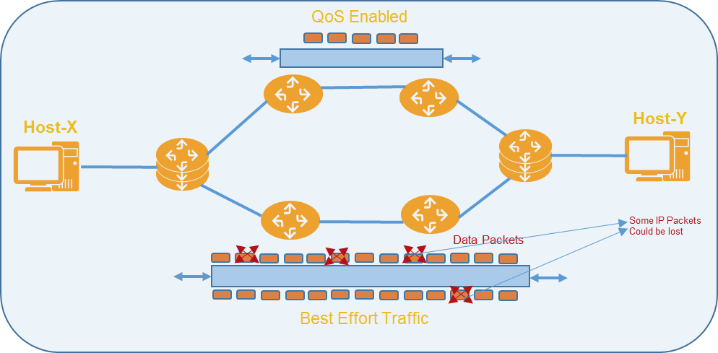

The Internet: Best Effort (throughput)
Lousy
What is Internet (throughput) fairness ? “all flows are created equal” ??? E.g.: competing 4K TV and Smartphone Paying more will not get you more throughput during congestion
How to achieve fairness ? Path-RTT, transport-protocol-aggressiveness
Guarantees ? Absolute reservation == scale issues Relative throughput easier !!
Limited by Loss and Capacity: Higher performance requires lower loss or higher overhead
Internet: Best Effort
“Best Effort” Per-Hop Behavior (PHB)
ECN / AQM (maybe)
“Shortest Path” routing
Throughput / Priority Guarantees
Latency Guarantee (path/queuing)
No-Loss guarantees
Jitter

Slide 13
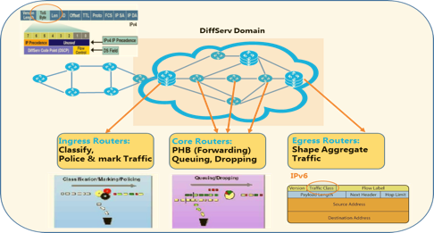
Rich QoS services in private IP networks
Archaic
configuration
nightmares
DiffServ in L2/L3 VPN / enterprise / DC
How do you calculate class-weights ?
Time dependent ?
Four-level Hierarchical (DiffServ) QoS.
One off SP / content provider hacks.
ACL for SP video
Co-location of OTT content servers in SP network
Different IP / MPLS / Ethernet QoS
Mapping nightmares, service/functionality loss
Per-flow “IntServ” services
Great for limited private networks, but does not scale to metro networks hop-by-hop
Beyond Internet:
D& ifferentiated Services
Integrated Services

Slide 14
Analyze applications Understand how network service: (throughput, loss, latency) impact user experience
Not even good MOS for AR/VR today! MOS = Mean Opinion Score
Initial , intermittent buffering
Probability / periodicity of non-congestion loss (NCL) Random (bit /packet errors) vs. Burst (outage) loss
Ability to conceal NCL (codec dependent) Ability to correct NCL (FEC, retransmissions)
Normal/Ideal quality (throughput)
Quality Variation by throughput variation Frequency, fine-grained (concealed)
Congestion Loss (*YUCK*), Self-Friendly-ness
Use-case: Digital Actor Single point cloud holographic object in a real scene

Slide 15
Coordinated Communications
Synchronized latency experience “Why can player 3 shoot /kill faster?”
(lowest RTT to server)
In-network latency fairness (vs. clients faking RTT)
Aggregate Network Resource Management
“Get N Gbps for 2 hours, split across parties as you like”
Scale optimizations with guarantees
Multicast: in-network replication to parties
Incast: Many to “virtual/cluster” one
Coordination may need to happen on many hope, or (depending on coordination function) on the edge of the network.
Use case: Synchronized Multi-Part Remote Collaboration

Slide 16
High-Precision Communications SLO (service level objective) based latency management
Let applications manage network latency (queuing, buffering)
End-to-end min..max latency control
Stateless == per-packet
Avoid scale limits of network flow-awareness
With/without (bandwidth) reservations E.g: dynamic adjust throughput, but keep low-latency
On-time: Delay early packets Reduces application side buffering / jitter
In-time Guarantees
On-time Guarantees
Use case: Latency sensitive streaming, control-loops

Slide 17
High-Precision Communications Example: Flows with different path length/hops
Typical metro network ”core” ring part with aggregation
Fair-latency for Flow 1 / Flow 2 ?
Flow 1 disadvantaged by physics (path latency, hops)
But can compensate with high precision communications:
Edge-coordination function: Assign same minimum end-to-end latency to both flows
Somewhat larger than flow 1 physical propagation latency.
When there is no contention: This just “delays” flow 2 packets in network to create fairness
Interesting under network contention/congestion
Intelligent latency aware queuing (node B, C) would know from BPP header that flow 2 packets have more time to spare in queuing… And dequeue flow 1 packets faster
Path/end-to-end latency based automatic queuing priorities.
Sender1
Destination 1
Flow 1
…
A
E
…
100x
100x
queue
queue
…
B
D
100x
queue
…
100x
Flow 2
Sender2
Destination 2
C
queue
…
100x
Use case: Latency sensitive streaming, control-loops

Slide 18








Qualitative Communications
Layered/Object media codecs / transport
e.g.: MPEG SVC, ALC RFC5775
Network awareness of Quality
Mapping to different per-packet network resources
E.g.: congest/(discard) highest-quality level first
Redundancy:
L3 In-network redundancy (FEC) insert/remove
From flows to packets:
When bitrates increase but not packet rates E.g.: Optical Switched Networks => huge packets
Packet-Chunks, tail-discard / congest / recover
Noisy link
Congested Node
Congested Node
Congested Node
Qualitative Packet
IP HDR
Use case: Scalable Gradual management of quality

Slide 19
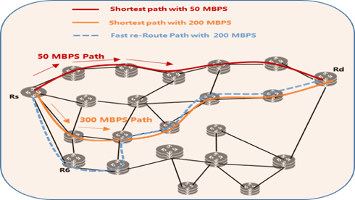
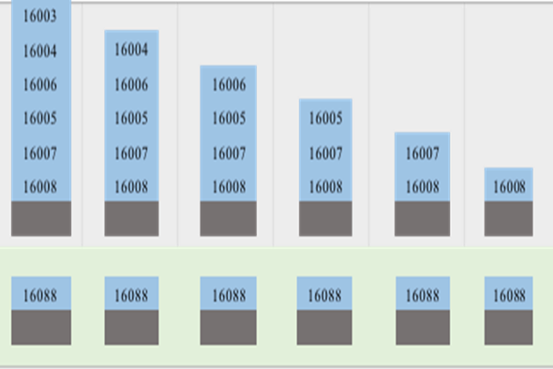
2020 State of Traffic Engineering
MPLS/RSVP-TE designed for Traffic Engineering (TE)
Traffic flow resource guarantees: bandwidth, latency, reliability
AC with path selection, FRR protection (sub 50ms), per-path/(hop) QoS
Complex, scaling limited for last two decades dominant use-case:
Capacity optimization
Maximize use of non-ECMP SP paths for best effort traffic
Segment Routing (SR-MPLS, SRv6)
Revives 1981 “loose source-routing”. Ideal for capacity optimization.
Simplifies routing architecture: Only IGP (ISIS, OSPF), no LDP.
Rightfully replaces RSVP-TE for capacity optimization
Source-routing not ideal for real TE problems
Header tax, undesired re-routing, per-hop-guarantees, monitoring
Difficult/impossible to apply to arbitrary forwarding planes
2030 Networks need to support real TE solutions
With similar optimization as SR did for capacity optimization
Non-equal-cost-path traffic steering
RSVP-TE SR-MPLS
Per-hop header tax (MPLS) SR vs.
Per-flow state based solutions (e.g.: RSVP-TE)

Slide 20

Lossless networking and path steering
Live-live: “near zero loss”, no added latency
Send two copies of same traffic across “disjoint” (no shared failure) paths
Used since 1990th for financial, military, video (SMPTE since 2010th)
All redundant networks have >= 2 disjoint paths. Value of critical traffic easily >= 2 * normal best effort traffic.
PREOF – Packet Replication Elimination Ordering Function
DetNet term for live-live solution. TSN also uses this.
Only working there in simpler topologies than those needed for 2030
(SR) Loose path-steering issues
Unexpected / unnecessary rerouting: When one path fails, rerouting it undesirable – but unavoidable with loose paths.
Header tax redundant when per-hop state needed anyhow:
Strict latency management (DetNet, TSN) (“shaping state”)
Monitoring / Diagnostic state, MTU
Real networks have long, complex paths
Especially in metro-space (up to 30 hops)
Special solutions for rings insufficient
A4
Source
A4
Source
A5
A5
A3
A6
A3
A6
A2
SR label
hop
A7
A2
SR label
hop
A7
A8
A1
A8
A1
Traffic copy 1
Traffic copy 2
Traffic copy 1
Traffic copy 2
Live-live transmission
In ring with SR
Rerouting under Failure
SENDER 1
RECEIVER 2
SENDER 2
RECEIVER 1
Sender sends same data twice, red and green
link/node failure interrupt only one copy of data

Slide 21
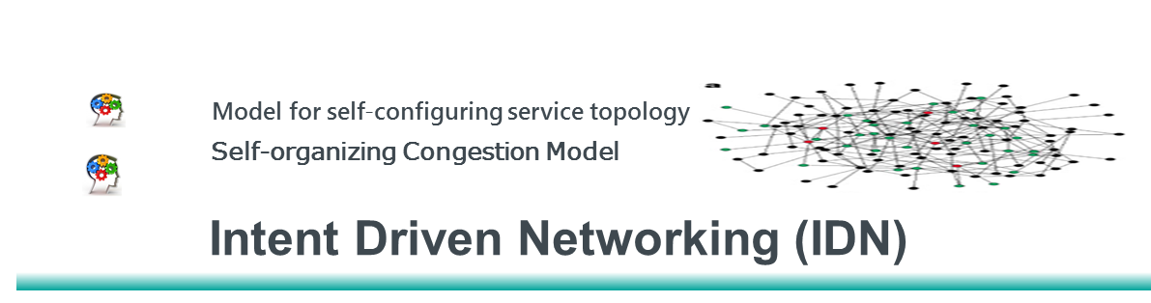
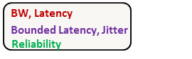

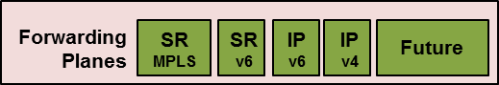
PPR – Preferred Path Routing
Novel Control-plane Signaling Architecture
Use IGP to signal TE information / replace RSVP-TE
PCE / AC (Path Computation Engine / Admission Controller) to network
Centralized PCE/AC or decentralized (edge nodes)
Unified for current and future forwarding planes
Strict/loose forwarding entries: IPv4, IPv6, SR-MPLS, Ethernet, future
PPR-ID: Identifier for a path == forwarding plane address
/32 for IPv4, /128 for IPv6, /20 for SR-MPLS,…
Per-hop QoS setup as necessary/desired
SW-update-only for existing forwarding planes
Orthogonal / combinable with SR
PPR when hop-by-hop state required.
SR for lightweight capacity maximization.
All the benefits of RSVP-PE without the limits
Efficient signaling via IGP instead of heavy hop-by-hop on-path
RSVP-TE only for MPLS forwarding plane.
centralized Path Computation Engine (PCE)
Shortest Path/Best Effort
decentralized
PCE
IGP
Area/Domain
decentralized
PCE
Core/P-nodes
decentralized
PCE
Edge/PE-nodes
distribution / flooding
Simple FIB
IP/L2 Packet
IP/L2 Packet
L2/IP Router FWD Plane
L2
Future
Fully backward compatible + extensible, lean path routing information on the Wire

Slide 22
PPR Graphs – scaling state
PE1
PE5
Point 2 point paths N² scaling issue
Worst case: network wide path optimization N source to N dest.
Full mesh NxN paths (RSVP-TE) . N²/k path across single node
SR: N*l source-route stacks in headers on each source node + N’ SID state
k = number of parallel path in network, l = average number of hops in network
PPR can signal “Graphs” from PCE to network
Aggregate per-hop-state whenever possible (determined by PCE)
No change in forwarding plane. Still simple “destination” forwarding entries
PPR-Tree
(Sub)set of senders in network to one destination.
Multiple Trees to same destination for different policies easily possible.
Set of 1 tree for each destination like a “Flex-Topology”, but with paths calculated by controller – easier than reverse-engineering SPF metrics.
PPR “Forest”
Shared graph for multiple destinations.
Allows for minimum amount of state in network, e.g.: for live-live services
Controller calculated path == better live-live paths than distributed MRT live-live
L1
P4
P1
PE2
P2
PE4
P7
PE3
PPR Tree: all possible sender to destination PE5
PE1
PE5
L2
P4
P1
PE2
P2
PE4
P7
PE3
Better PPR Tree for some subset of sender
A4
A5
A4
A5
A3
A6
A3
A6
PPR Forest1
PPR Forest 2
A2
clockwise
A7
A2
counter
clockwise
A7
A1
A8
A1
A8
Sender
Dest
Sender
Dest
2 PPR Forests representing any path in ring topology

Slide 23
Technologies for 2030 Networks
WHY, WHERE, WHO, HOW, WHAT
GREAT SUCCESS !!!!!
But wait… there is more (to do)

Slide 24
Vision Network 2030
Holographic Society and Industry
2D
3D
Gbps
Tbps
2 Senses
5 Senses
MS
Sub-MS Latency
New Media
Network 2030
Next wave of
Internet Innovations
OneNet ManyNets
Mbps Gbps/Tbps Access
Computing in Networks
New
Services
New
Infrastructures
Lossless Networking
High-Precision Communications
Holographic Type Communications
Converged Terrestrial and Space
Fidelity and Trust
Federated Networks

Slide 25
Publications and Talks
Concepts
A New Way to Evolve the Internet, A Keynote Speech at IEEE NetSoft 2018, Montreal, Canada, June 2018
What if we reimagine the Internet?, A Keynote Speech at IEEE ICII 2018, Bellevue, Washington, USA, Oct 2018
Framework and Architecture
A New Framework and Protocol for Future Networking, ACM Sigcomm 2018 NEAT Workshop, Budapest, August 20, 2018
New IP: Design for Future Internet with New Service Capabilities Envisioned, IEEE ICC Industry Tutorial, 2019
Market Drivers and Requirements
Towards a New Internet for the Year 2030 and Beyond, ITU IMT-2020/5G Workshop, Geneva, Switzerland, July 2018
Network 2030: Market Drivers and Prospects, ITU-T 1st Workshop on Network 2030, New York City, New York, October 2018
Next Generation Networks: Requirements and Research Directions, ETSI New Internet Forum, the Hague, the Netherlands, October 2018
The Requirements for the Internet and the Internet Protocol in 2030, ITU-T 3rd Workshop on Network 2030, London, Feb 2019
New Technologies
Preferred Path Routing – A Next-Generation Routing Framework beyond Segment Routing, IEEE Globecom 2018, December 2018
Flow-Level QoS Assurance via In-Band Signaling, 27th IEEE WOCC 2018 , 2018
Using Big Packet Protocol Framework to Support Low Latency based Large Scale Networks, ICNS 2019, Athens, 2019
Use Cases and Verticals
A Novel Multi-Factored Replacement Algorithm for In-Network Content Caching, EUCNC 2019, Valencia, Spain
Distributed Mechanism for Computation Offloading Task Routing in Mobile Edge Cloud Network, ICNC 2019, Honolulu, USA
Enhance Information Derivation by In-Network Semantic Mashup for IoT Applications, EUCNC 2018, Ljubljana, Slovenia
Latency Guarantee for Multimedia Streaming Service to Moving Subscriber with 5G Slicing, ISNCC 2018, Rome, Italy

Slide 26
References
Holographic content considerations methods for efficient data transmission and content creation methodologies
Point Cloud Compression in MPEG MP20 Workshop Hong kong 2017
Keynote: the near future of immersive experiences: where we are on the journey, what lies ahead, and what it takes to get there.
Architectures and codecs for real-time light field streaming journal of imaging science and Technology , January 2017
A Dynamic Compression Technique for Streaming Kinect-Based Point Cloud Data (2017 International Conference on Computing, Networking and Communications (ICNC): Multimedia Computing and Communications)
Technical White Paper on Mobile Bearer Network Requirements for Mobile Video Services.
On the Support of Light Field and Holographic Video Display Technology, Light Field Lab, Inc., San Jose, CA. “The road to immersive communication,” Proceedings of the IEEE, vol. 100, Apr. 2012.

Slide 27
Thank You
Comments, Curious, Questions?
Toerless.Eckert@futurewei.com

